Slide 1

M.S. Applied Data Science Final Portfolio Presentation
Minyang Wang
Notes:
Hello Everyone, My name is Minyang Wang, Majored in M.S. Applied Data Science Program and I’m graduating this December .
This is my Final Portfolio Presentation that will show you what I did and learnt during my study in this Program. And most important thing is to show that I meet the requirements to graduate.

Slide 2

content
Personal background introduction
Academic study in M.S. ADS program
Program learning objectives achievement
Notes:
My presentation mainly consists of 3 parts, first I’ll briefly introducing myself and talk about why I choose the ADS program. Then I’ll talk about some projects that I did from the ADS program and finally I’ll talk about how these projects developed my skills and helped to achieve the program achievement. .

Slide 3
Personal Background
Bachelor’s degree in Economics
Master of Public Administration in Maxwell school
IST 687
Enrolled in M.S. Applied Data Science Program
Notes:
Before I entered the ADS program, I first gained my bachelor’s degree in economics in Renmin University of China and then I came to Syracuse University to study MPA program in Maxwell school. It was in that spring semester I took the IST 687 introduction to data science as my elective course, and I gained strong interest in the data science field. I found it was so amazing to use the data and algorithm to solve the problems in the real life. I also realized that in the future, no matter in which industry, in private sector or public sector, the demand of data analysis will grow dramatically. Then I applied the ADS program and this one and half year of experience tells me that my decision was correct.

Slide 4
Academic study in M.S. ADS program
IST 687 Introduction to Data Science
MBC 638 Data Analysis & Decision Making
IST 659 Database Administration Concepts and Database Management
IST 707 Data Analytics
IST 736 Text Mining
IST 652 Scripting for Data Analysis
IST 718 Big Data Analytics
IST 719 Information Visualization
SCM 651 Business Analytics
FIN 654 Financial Analytics
IST 664 Natural Language Processing
IST 722 Data Warehouse
Notes:
These are all the courses that I have taken in the ADS program. They cover all the field of data science, I learned how to analyze the data and text data, how to build the database and data warehouse, how to visualize the data, and how to apply the data science technology to business and financial area. In my portfolio document I introduced 6 course projects and considering the time limit of this presentation, I’ll just talk about three projects that can show my achievement in the ADS program. I’ll talk about the IST 687 introduction to data science, IST 659 database management and IST 718 big data analytics.

Slide 5

IST 687 Introduction to Data Science
Hyatt Hotel Analysis: Recommendations to Improve Net Promoter Scores
Notes:
The first I took from iSchool is IST 687 introduction to data science. This course provides applied examples of data collection, processing, transformation, management, and analysis as well as a hands-on introduction to the emerging field of data science. Let me introduce the first project that I did
The purpose of this project is to demonstrate and exhibit a high-level analysis based on the data gathered from Hyatt and their customers ratings. Each group was asked to analyze the Hyatt customer data and provide suggestions to increase the NPS (Net Promoter Score) score of the hotel based on their analysis.
Before I start I would like to introduce what is the NPS. The net promoter score measures the willingness of customers to recommend a company‘s products or services to others. If a customer’s likelihood to recommend a product is 9 or 10, we defined him as a promoter; if the likelihood to recommend is 7 or 8, we say he is a passive and if the likelihood to recommend is less than 6, he is a detractors. The NPS is, given a product, the percentage of its promoters minus the percentage of its detractors. So the higher the NPS is, the more likely that the customer would introduce this produce to others. So in order to increase the NPS, we hope there will be more promotors and less detractors.

Slide 6
IST 687 Introduction to Data Science
Business questions:
Which state in the country and area within a state and hotel type will provide the most useful information to improve NPS scores?
Which satisfaction metric including guest room satisfaction, tranquility satisfaction, hotel condition satisfaction, staff cared satisfaction, customer service satisfaction, internet satisfaction and check in satisfaction is most important in predicting a promoter or detractor customer type?
Notes:
The big objective of this project is to improve the NPS score of the hotel, in other words, is to make the customers to give higher rating score to the Hyatt hotels. This is a very big question and our group decided to break it into some small business questions.
So first of all we would like to see Which state in the country and area within a state and hotel type will provide the most useful information to improve NPS scores? Because the data covers the information of the hotels from the whole world, it’s impossible to think of a way to improve the NPS score for the hotel of the entire world. So we decided to just target on one specific type of hotels in one specific area of one state to analyze in this state what can the hotels do to improve their NPS score.
Then, we selected several attributes that we thought they may influence the customers of becoming a promoter or detractor. We wanted to see which variable has the strongest influence on making a customer a promoter or a detractor, so the hotel can target on this variable to improve its NPS.

Slide 7
IST 687 Introduction to Data Science
Data preprocessing:
Raw data: 15 million rows, 237 columns
Target on business hotel in urban area in California
Cleaned data: 110 thousand rows, 13 columns
Notes:
After we have clear business questions and before we start the data analysis, we need to clean the data. The original data consists of 12 csv files storing the data of each month in the year 2014. In each csv file there are more than 1 million rows and more than 200 columns, so in total there are around 15 million rows and 237 columns. As I have mentioned in last part, we first targeted to the business hotel in urban area in California, because this specific type of hotel has the largest amount of data. We also removed irrelevant columns and NA, and finally our cleaned data has 110 thousand rows and 13 columns.

Slide 8
IST 687 Introduction to Data Science
Data analysis:
Probit model
linear model
Association rules model
Notes:
Our data analysis focused on looking for the attributes which contribute the most to influence a customer to become a promoter. We built probit model which is similar to logit model which predicts dummy dependent variable. We also built the linear model to predict the likelihood to recommend score with the variables we selected. For the association rules model, we tried to find the association between the variables and the different customer type. So we can increase the net promoter score by improving the most important factor.

Slide 9
IST 687 Introduction to Data Science
Probit model:
Variables: Check in satisfaction, Hotel condition, Customer service quality, Guest room satisfaction, Internet satisfaction, Staff attitude, Tranquility.
One point increase in guest room satisfaction metric will lead to 11.39% increase in the possibility of having a promoter type of guest.
Similarly, each increase in customer service satisfaction metric contributes 11.05% higher possibility of having a promoter type of guest.
One point increase in guest room satisfaction metric will lead to 1.73% decrease in the possibility on having a detractor type of guest.
One point Increase in customer service satisfaction metric contributes 1.68% lower possibility of having a detractor type of guest
Notes:
First we built the probit model. We select 7 satisfaction metric as the independent variables, we have the Check in satisfaction, Hotel condition, Customer service quality, Guest room satisfaction, Internet satisfaction, Staff attitude, Tranquility. Each of them measures the customer’s satisfaction about the hotel in the specific domain. Each independent variable ranges from 0 to 10.
We found that …
So according to the probit model, we found that the guest room satisfaction and customer service satisfaction are the most important factors. Both detractor and promoter customers care about the two the most.

Slide 10
IST 687 Introduction to Data Science
Linear model:
Variables: Check in satisfaction, Hotel condition, Customer service quality, Guest room satisfaction, Internet satisfaction, Staff attitude, Tranquility
Customer service quality and guest room satisfaction are still the most important contributor to high LTR(Likelihood to recommend).
With one unit metric increase in customer service quality and guest room satisfaction, respectively the LTR will increase by 0.35 and 0.34 out of 10.
Guest room satisfaction and customer service quality are the most important factors.
Notes:
Similar to the probit model, our linear model has the same independent variables. The only difference is the dependent variables, here we used the likelihood to recommend score as the dependent variable.
We found that …

Slide 11
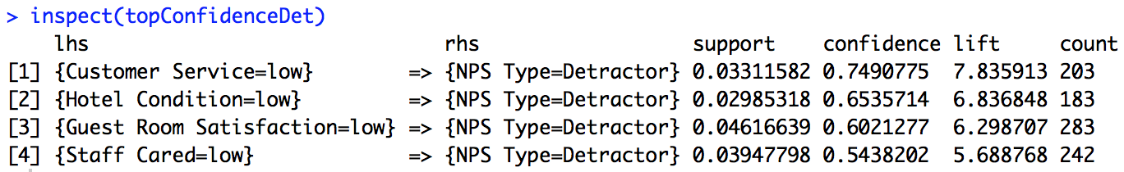
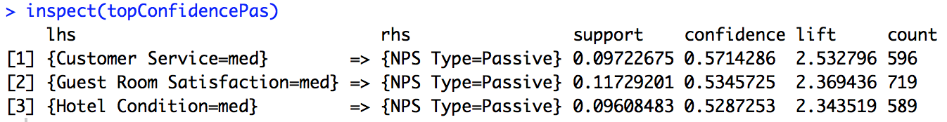
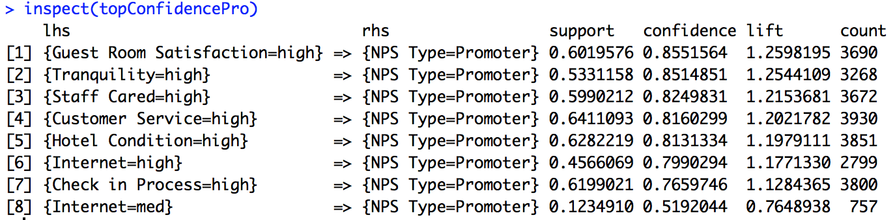
IST 687 Introduction to Data Science
Association rules model:
Notes:
Finally we built the association rule model. We convert all the satisfaction metric into satisfaction level ,with 1 to 6 being low, 7 to 8 being medium, 9 to 10 being high.
For detractor, when customer service, hotel condition, and guest room satisfaction are low, the customer is more likely to be a detractor.
For instance, 74.9% of the customer who give a low score in customer satisfaction, are detractor.
for passive, when customer service, hotel condition, and guest room satisfaction are medium, the customer is more likely to be a passive.
For promoter, we can also see that when tranquility, staff cared, customer service, hotel condition, and guest room satisfaction are high, more than 80% of the time, the customer is a promoter.
Therefore, if we look at all three parts together, we can see that increasing customer service, hotel condition, and guest room satisfaction will pull the detractor to the passive and the passive to the promoter.

Slide 12
IST 687 Introduction to Data Science
Actionable insights/Recommendations :
Hyatt should focus more on guest room satisfaction, customer service quality and hotel condition in order to increase NPS score
Investing in better or more frequent staff customer service training and upgrade expectations of hotel cleanliness and train staff on new policies
Updating furniture, technology and facilities to ensure hotel is in its best condition
Notes:
This is the first project that I finished in the ADS program, now looking at it there are lots of parts that needs to modify and improve including the data cleaning, model selecting, feature engineering and so on. But from this project I learned to use R to preprocess the data such as removing NAs, to do the descriptive analysis such as aggregating dataframe and plotting graphs, to use different algorithms to do the machine learning analysis. In the course project I got the chance to incorporate the theoretical knowledge with the real-world problem which makes this course more practical.

Slide 13
IST 659 Data Admin Concepts & Db Mgmt
Curriculum Information Sharing System Design
Notes:
Database Management is a course that provide. Fundamental Knowledge and the most important knowledge for a person who want to get into Information Tech area. It teaches basic knowledge of database including administration rules, relational table building and manipulation data.
Software used: Microsoft SQL and Access
For this course project, I built a course information sharing platform which provides detailed course information for the SU graduate students. Besides the course time, professor and location, this database will also provide other information such as the course syllabus link, the professor’s resume link, the average grade of the previous students who have taken this course. For the student’s usage, this platform can help SU students better select courses before the start of each semester. And for the professor’s usage, a professor can use it to check the course and student information to better know the students in his class.

Slide 14

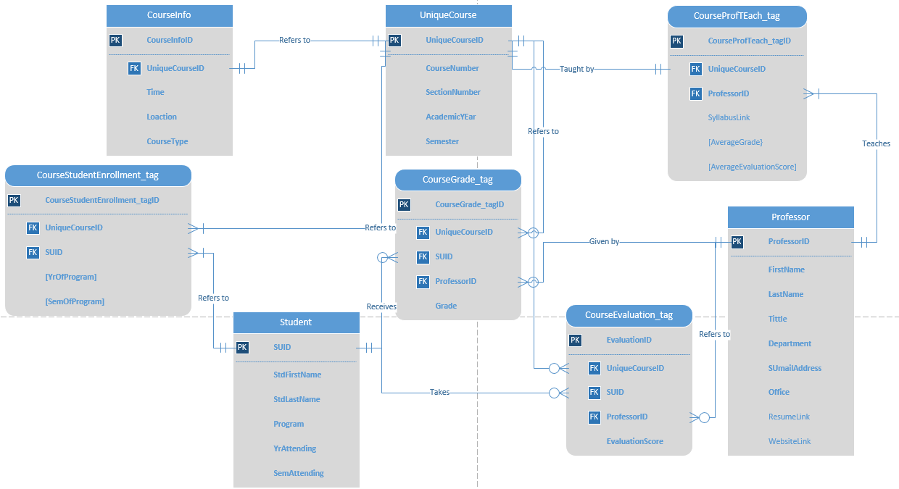
IST659 Data Admin Concepts & Db Mgmt
Notes:
This is the Entity Relation Diagram of my project. There are 8 entities in total. There are three main entities, student, course, and professor. The other entities connect the three main entities, and represent the one to many or many to many relation between the main entities. For example, let’s look at the courseStudentEnrollment_tag entity, each row in this entity represents one student taking one course, one student can take multiple courses but one course enrollment tag can only refers to one student, so the relation between the student entity and the coursestudentenrollment tag entity is one to many, similarly, the relation between the course entity and the coursestudentenrollment tag entity is also one to many.

Slide 15
IST659 Data Admin Concepts & Db Mgmt
Notes:
Here we can see each attribute in each table. All of the related information that need to be collected are shown in this table.

Slide 16
IST659 Data Admin Concepts & Db Mgmt
Notes:
According to the ERD and Entity Attributes Table, I used Microsoft SQL to create the database. This is the sample of Creating Tables by using SQL

Slide 17
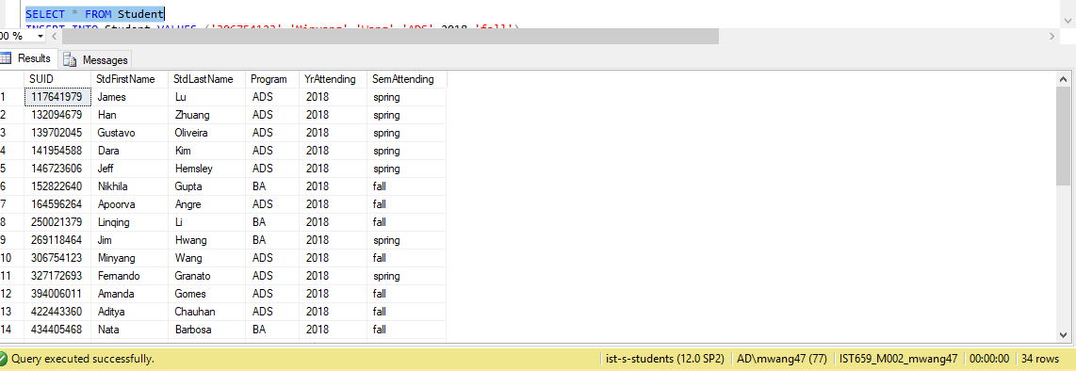
IST659 Data Admin Concepts & Db Mgmt
Notes:
After the tables are created, I inserted sample data. This is the SQL sample of inserting data

Slide 18
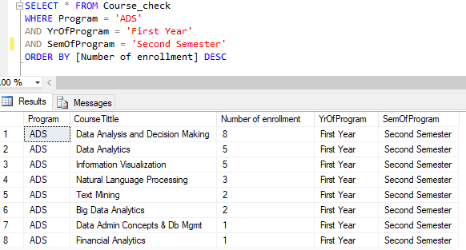
IST659 Data Admin Concepts & Db Mgmt
Notes:
Then I got the tables with data. As I have mentioned before, this database can be used for both students and professors. Let’s first have a look at how it can help students to select courses. This SQL Sample shows how we manipulate the data to answer question including the use of View and Aggregating Functions.
Let’s say an ADS student wants to know in the second semester of his first year of ADS program, what courses are the most popular. The result indicates that Data Analysis and Decision Making, Data Analytics and Information Visualization are the top 3 popular courses in the second semester of the first year of ADS program. Then he can consider enrolling these courses in his coming semester.

Slide 19
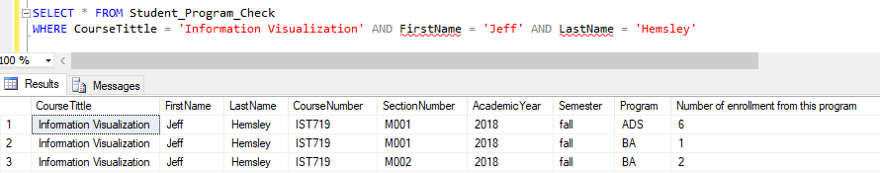
IST659 Data Admin Concepts & Db Mgmt
Notes:
Then for the professor’s usage, lets say professor Jeff Hemsley wants to see the program distribution of students taking his IST 719 information visualization. He gets to know that in 2018 fall semester, in the M001 section there are 6 students from ADS program and 1 from BA program, so in this section he can design his class more relevant to data science field; and in the M002 section all the 2 students are from BA program, so in this section his class can be more related to business application.

Slide 20

IST659 Data Admin Concepts & Db Mgmt
Notes:
After created the database, I used Access to Build an Interface for users to connect to the database easily. Lets take a brief look at how a student use this database system to query course information he needs.

Slide 21
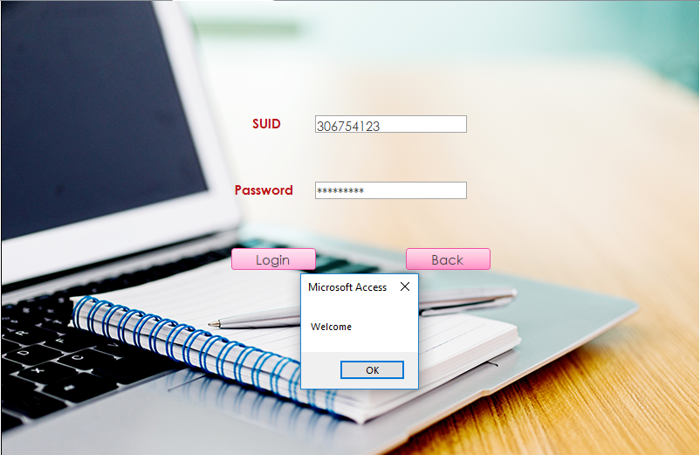
IST659 Data Admin Concepts & Db Mgmt
Notes:
The student need to first login the system by his SUID and password

Slide 22
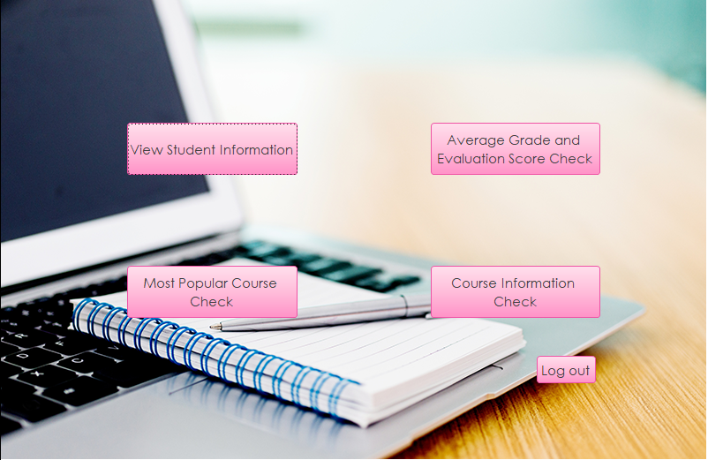
IST659 Data Admin Concepts & Db Mgmt
Notes:
After the student successfully login in his account, he can choose to view his or other students’ information, to check the most popular courses in SU, to check the average grade and evaluation score of all the courses, or to check the detailed information of every course. After he has queried the information he wanted, he can click on the “Log out” button to quit his account. Let say the student wants to check the most popular course.

Slide 23
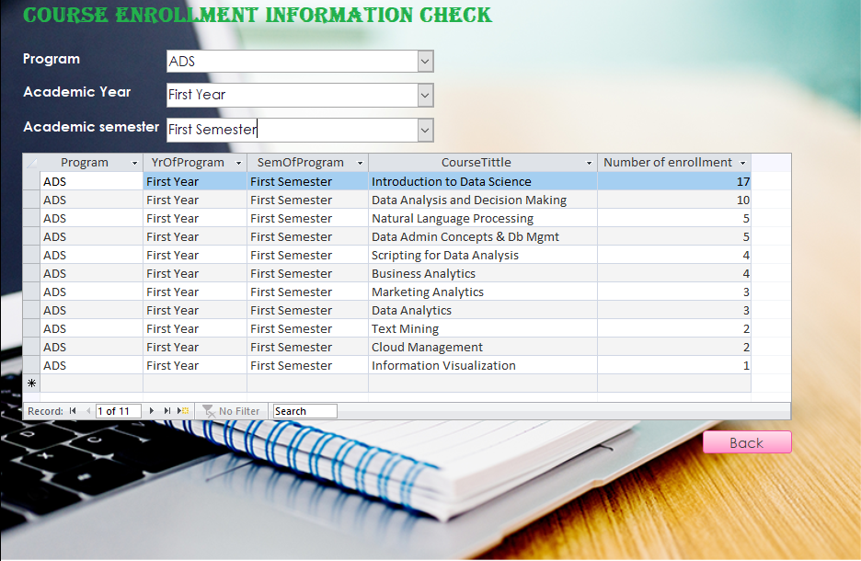
IST659 Data Admin Concepts & Db Mgmt
Notes:
Student can select his program, program year and program semester in the combo box to query the most popular courses in the given program.
This is all about the course project of IST659 database management.

Slide 24
IST 718 Big Data Analytics
Gstore Revenue Prediction
Notes:
The next course project I would like to introduce is my project of IST 718 Big data analytics.This course is a broad introduction to modern techniques in data science including elastic net regularized regression, random forest, gradient boosting, and deep learning. It emphasizes a statistical learning point of view, and a careful examination of generalization error, model interpretability, feature engineering, and bias-variance tradeoff.
For the course project, I and my group members utilized the google online store data to predict whether a user would consume during his visit to the online store website. So google can efficiently cast more advertisement to potential customers who have higher probability of buying products to maximum the profit.

Slide 25
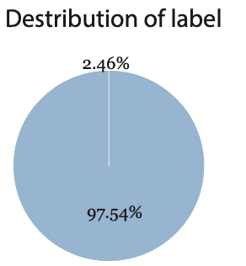
IST 718 Big Data Analytics
Data Description:
1.7 million rows and 50+ columns
Label: whether a visitor consume or not
Focus on US area data
Cleaned dataset: 0.7 million rows and 33 features
Test, Validation, Training Dataset
Notes:
The data set was from a kaggle competition, and original it has 1.7 million rows and more than 50 columns. Each row records the information of one single visit to the google online store. The dependent variable is a dummy variable that whether a user consume during his visit to the google online store. Because the data set was too big, we decided to just focus on the US area data and after removing irrelavent columns and rows there are 0.7 million rows and 33 columns left. We also split the data into training, validation and testing dataset. Before we start our analysis, we faced a big challenge, the data is highly biased that more than 97% of the visit to the store didnt generate revenue.

Slide 26
IST 718 Big Data Analytics
Model building:
Oversampling training dataset in order to deal with imbalance data, and we trained following models to make prediction:
Logistic Model
- with PCA component from 1 to 31
- without PCA
Random Forest
- Max Depth from 1 to 15
- Number of Trees from 1 to 101
GBM Classifier
- Max Iterator from 1 to 21
- Max Depth from 1 to 5
Notes:
Because the data is unbalanced, before we train our model, we need to oversample the training dataset to make the number of the two labels almost the same. We built 3 models to predict whether a visitor would consume in the store.
First we built the logistic model, and because there were too much independent variables we decided to do the principal component analysis to reduce the dimension of the independent variables. To validate the logistic model, we change the number of component from 1 to 31 to compare the prediction performance. And we did also build a logistic model without PCA process that we put all the independent variables into the model.
Then we built the random forest model, we tuned the model by modifying the max depth parameters from 1 to 15 and by changing the number of trees from 1 to 101 to get the best random forest model.
Lastly we built the gradient boosting machine model and validate the model by changing the max iterator from 1 to 21 and by changing the max depth from 1 to 5.

Slide 27
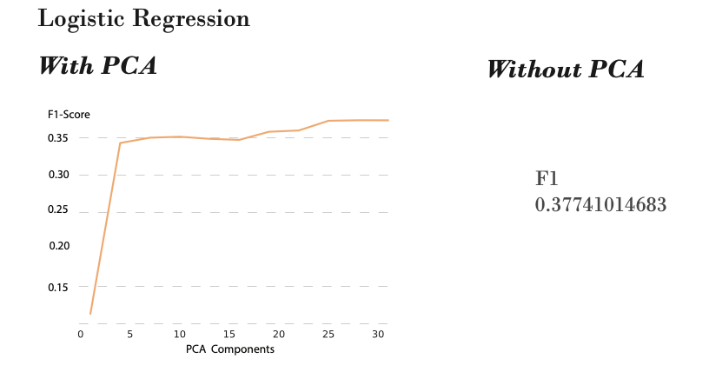
IST 718 Big Data Analytics
Model Comparison (Validation):
Notes:
Because we have just oversampled the training dataset to train the model and the validation dataset is still very biased. So we cannot use the prediction accuracy to evaluate the model’s performance. So we used the F1 score to evaluate the model. Lets first look at the validation result of the logistic model. This graph indicates that as the number of component increases the F1 score increases. But if we look at the F1 score of the logistic model without pca process, its F1 score is higher than the F1 score of the model with PCA. Therefore, the PCA doesn’t help to improve the logistic model.

Slide 28
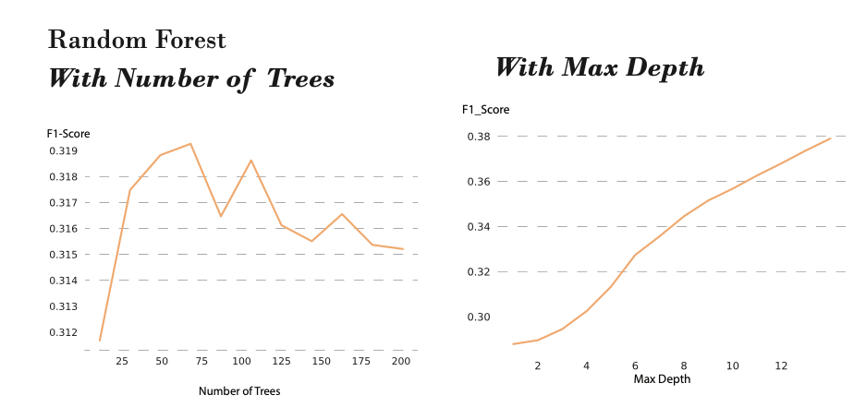
IST 718 Big Data Analytics
Model Comparison (Validation):
Best model:
Number of trees = 60
Max depth = 15
F1 score = 0.373
Notes:
Then let’s look at the result of the random forest model, as the number of trees parameter increases, the F1 score first increase and then decrease, which means the model first underfit and then overfit the validation data. So when the number of trees equals to around 60, the model gets its best performance. And for the max depth parameters, the F1 score increases as the max depth increases. So we set the number of trees equals to 60 and max depth equals to 15, we got the best random forest model, and the F1 score is 0.373.

Slide 29
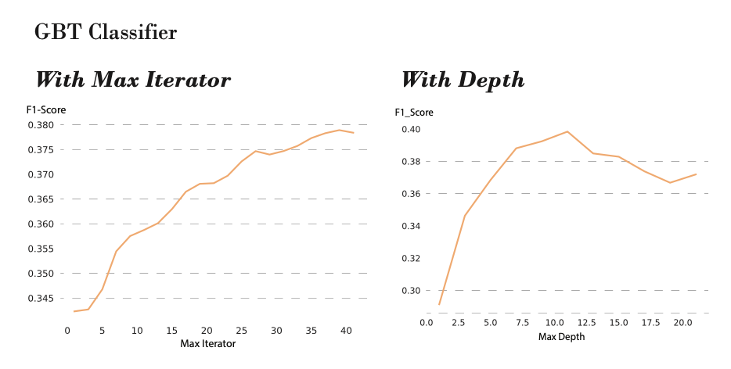
IST 718 Big Data Analytics
Model Comparison (Validation):
Best model:
Max iterator = 38
Max depth = 11
F1 Score = 0.4054
Notes:
Finally lets look at the gradient boosting tree model, similarly to the previous model. We changed the parameter values and got our best model when the max iterator is equal to 38 and max depth is equal to 11. The model’s F1 score is 0.4054 which is the highest among all the models.

Slide 30
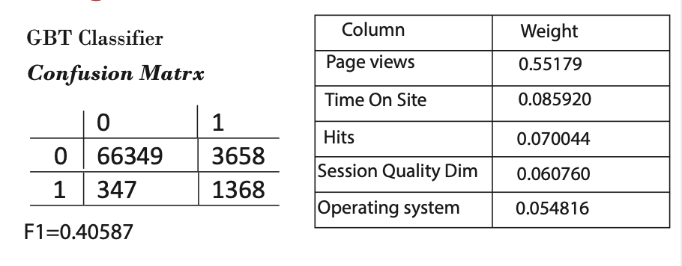
IST 718 Big Data Analytics
Testing the data:
Notes:
Finally we applied the gradient boosting tree model to the test dataset and got the F1 score 0.406 which is similar to the validation result. So our model did not overfit the data. As can be seen in the left side confusion matrix, the model mis-predicted a lot of non-customers as a potential customer, , which will cause a lot of extra spend on campaign
The right side shows the feature importance of this model. We can see that page views and time on site are two most important deciding features. The number of page views have the highest weight(55%) .
The project is a process of finding problem and solving problem, from unable to upload large cvs file to Python, to Python shutdown due to the massive computation when running for loop to tune the model. By searching the solutions to these problems online, I learned much more than what the professor had taught in the lecture. I did acquire the ability of problem self-diagnosis and problem self-solving, which are the most important basic skills that a data analyst should possess.

Slide 31
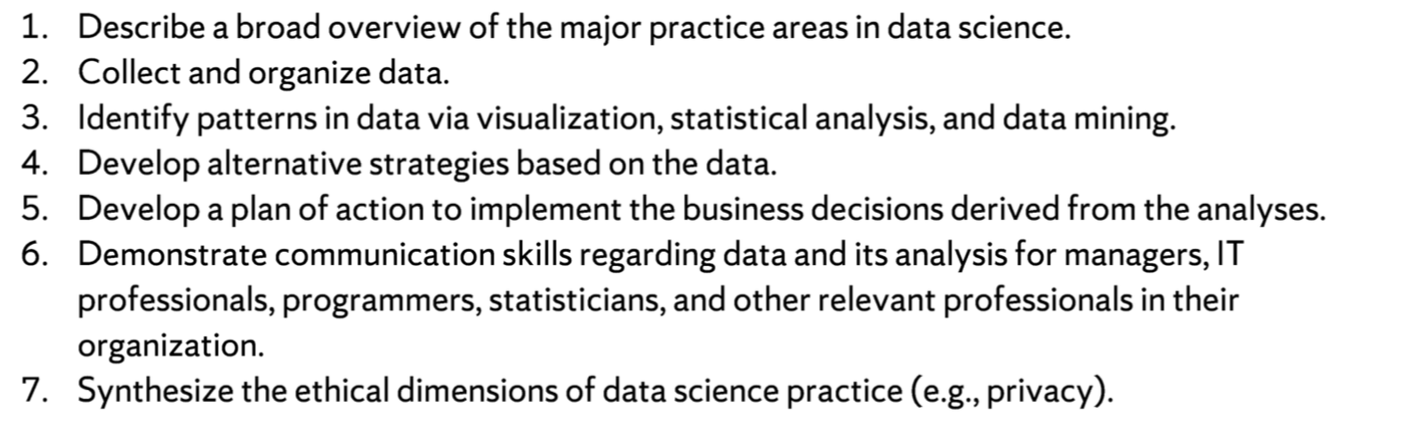
Program learning objectives achievement
Notes:
Finally let me spent some minutes talking about how these projects demonstrate my mastery of the program objectives.
All the projects are practical and are related to our real-life and incorporates the data science to the real-world problems.
The projects in Database Management shows my ability to collect and organize data.
The graphs in the IST 687 and IST 718 projects prove that I can use visualization combined with statistical analysis and data mining
For the Google store revenue prediction project, we changed the model evaluation matric from prediction accuracy to F1 score shows that I can develop alternative strategies based on the data.
In Hyatt hotel analysis project we did give actionable suggestions for the hotel to increase the NPS, which proves that I can develop a plan of action to implement the business derived from the analyses.
This presentation itself proves my communication skills.

Slide 32
Academic study in M.S. ADS program
Thanks for listening!
Notes:
I think the different kinds of projects are one of the best features of the ADS program. By doing the projects I learnt the practical and useful skills that will help me achieve success in my career life. I will always remember the days in the ADS program and I will always take pride of being a student in iSchool.
Thank you for listening to my portfolio presentation.

